Slide 1
CDA 3101 Spring 2016
Introduction to Computer Organization
Computer Performance
14 January 2016

Slide 2
Overview
Performance evaluation
Limitations
Metrics
Processor performance equation
Performance evaluation reports
Amdahl’s law

Slide 3
Performance Evaluation
Program
Compiler
CPI
ISA
Microarchitecture
Hardware
Manufacturing

Slide 4
Performance Evaluation Concepts
Computer performance evaluation is based on:
  Throughput (bits per second)
  Response time (a.k.a. execution time, elapsed time)
Component- and system-level performance
Processor performance evaluation
  Based on execution time of a program:
  Performance_{X} = 1/ Execution time_{X}
  Relative performance: n = Performance_{X} / Performance_{Y}
    n > 1 => X is n times faster than Y
Terminology
  Improve performance = increase performance
  Improve execution time = decrease execution time

Slide 5
Example
Impact on throughput and response time of:
  Using a faster processor
    Decrease in response time
    Increase in throughput
  Adding more processors to a system
    Increase in throughput
    Decrease in response time (if overhead is low)
      In Massively Parallel Processors (MPP)
      In Symmetric Multiprocessing Processors (SMP)
        Only if additional processors reduce queue time

Slide 6
Measuring Performance
Components of the execution time of a program:
  CPU execution time
    User CPU time
    System CPU time
  I/O time
  Time spent running other programs
Unix time command
time cc prog.c
9.7u 1.5s 20 56%
9.7u = 9.7 sec User CPU time
1.5s = 1.5 sec System CPU time
20 = Total Elapsed Time
56% = Percent CPU time

Slide 7
CPU Performance Equation
CPU time = CPU clock cycles * cycle time
= CPU clock cycles / clock rate
  CPU clock cycles = IC * CPI
    IC: instruction count (number of instructions per program)
    CPI: average cycles per instruction
CPU time = IC * CPI * cycle time
  seconds instructions clock cycles seconds
  program program instruction clock cycle
CPU clock cycles = Σ_{i} (CPI_{i} * IC_{i})
  IC_{i} : count of instructions of class i
  CPI_{i} : cycles that takes to execute instructions of class i
*
*
=

Slide 8
Scope of Performance Sources
CPU time = IC * CPI * Cycle time
Program
Compiler
ISA
Microarchitecture
Hardware
Abstraction level interdependence

Slide 9
Example 1
A program runs in 10 secs on a 3.5 GHz processor. A designer wants to build a new computer that can run the program in 6 secs by increasing the clock frequency. However the average “new” CPI will be 1.2 times higher.
What faster clock rate should the designer use?
10 IC * CPI / 3.5 GHz (current exec. time)
6 IC * 1.2 CPI / X GHz (target execution time)
Solve for X, to obtain X = ___ GHz
=

Slide 10
Example 2
Comparing two compiler code segments
Which code sequence executes the most instructions?
Which will be faster? S₁ = 2 . 1 + 1 . 2 + 2 . 3 = 10 cyc
S₂ = 4 . 1 + 1 . 2 + 1 . 3 = 9 cyc
Instruction class i | CPI_{i} for instruction class i
A | 1
B | 2
C | 3
Code sequence | Instruction counts (IC_{i}) for instruction class
 | A | B | C
1 | 2 | 1 | 2
2 | 4 | 1 | 1

Slide 11
Components of the CPU Equation
IC Instruction count
  Compiler
    Instruction set simulator
    Execution-based monitoring (profiling)
CPI if pipelined execution is used
CPI_{i} = Pipeline CPI_{i} + Memory CPI_{i}
Clock cycle time
  Timing estimators or verifiers (complete design)
  Target cycle time

Slide 12
Performance Evaluation Programs
Ideal situation: known programs (workload)
Benchmarks
  Real programs
  Kernels
  Toy benchmarks
  Synthetic benchmarks
Risk: adjust design to benchmark requirements
  (partial) solution: use real programs
    Engineering or scientific applications
    Software development tools
    Transaction processing
    Office applications
Convenience
Realism

Slide 13
Performance Reports
Reproducibility
  Include hardware / software configuration
  Evaluation process conditions
Summarizing performance
  Total time: CPU time + I/O time + Other time
  Arithmetic mean: AM = 1/n * Σ exec time_{i}
  Harmonic mean: HM = n / Σ (1/rate_{i})
  Weighted mean: WM = Σ w_{i} * exec time_{i}
  Geometric mean: GM = (Π exec time ratio_{i})^{1/n}
    ^{GM (X}i^{) X}i
    ^{GM (Y}i^{) Y}i
=
Important Stuff

Slide 14
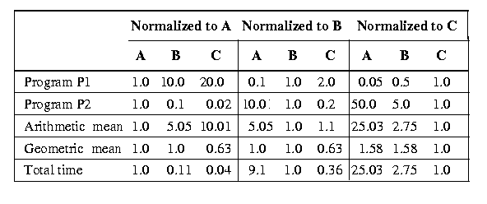
Arithmetic and Geometric Means
A B C
P1 1 10 20
P2 1000 100 20
Execution time (in seconds)
machines: A, B, and C
programs: P1 and P2

Slide 15
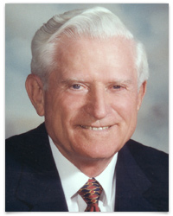
Amdahl’s Law
Law of diminishing returns for acceleration
Execution time before improvement
Execution time after improvement
Speedup =
Example: Two cases - F1: 25% improved 2X, F2: 50% improved 2X
75 percent not improved
F1
F2
50 percent n.i.
Time →
1
(1 - fraction enhanced) + (fraction enhanced/factor of improvement)
Speedup =

Slide 16
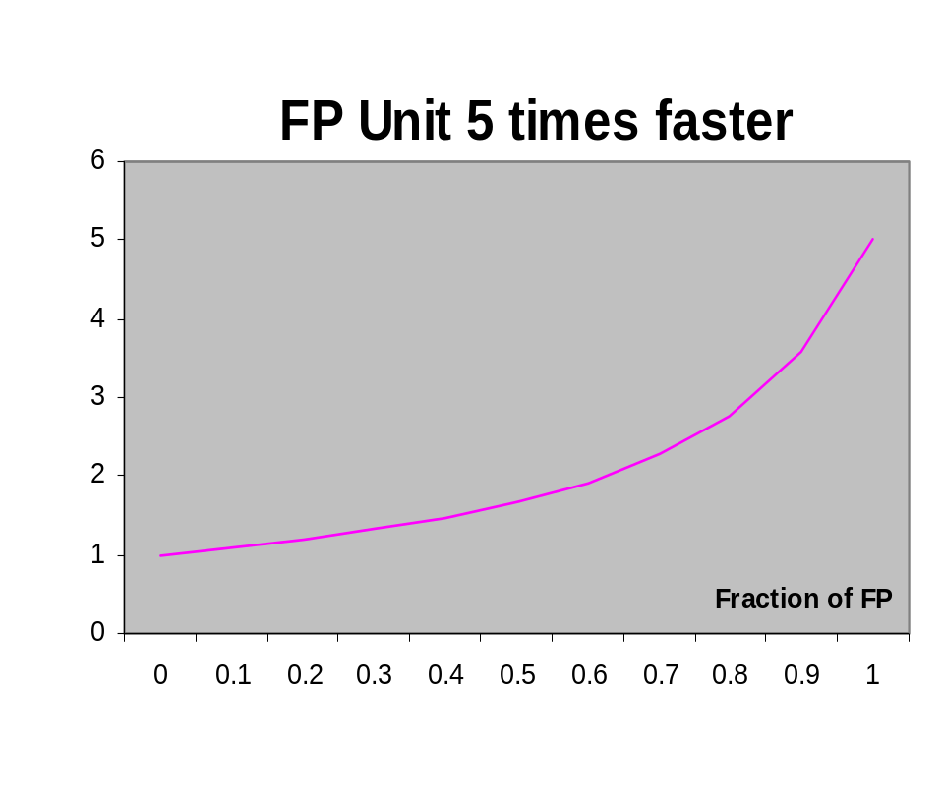
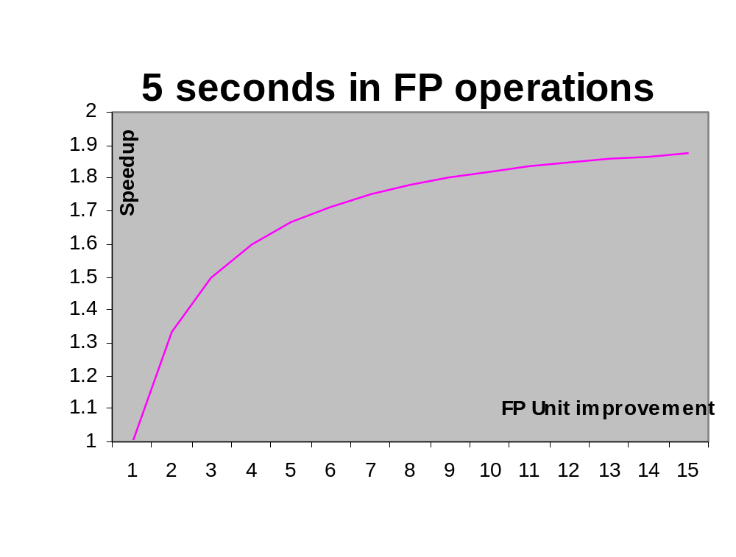
Example
A program runs in 10 seconds
What is the speedup after a faster floating point unit is incorporated?
1
Speedup =
(1 – Fraction FP) + FractionFP
5
Speedup =
1
0.5 +
0.5
FP factor of improvement

Slide 17

Conclusions
Many different performance data
  CPU time, I/O time, Other time, Total time
Select best presentation method
  Arithmetic mean for execution times
  Geometric mean for performance ratios
Watch out for Amdahl’s Law
  Diminishing returns w/ improved performance
  Impacts of development
Co$t

